Slide 1
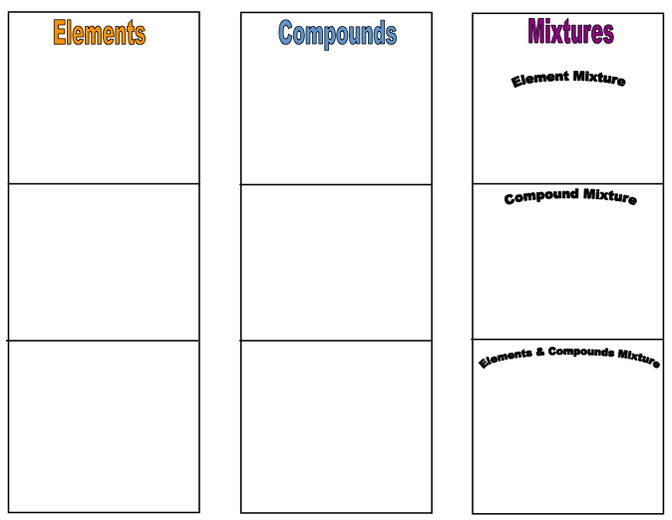
Station #1: Building Blocks
On 1 page of each of your notebooks paste directions and chart where your work will go
Read instructions
Please complete with math connecting blocks and color pencils
You have 7min

Slide 2
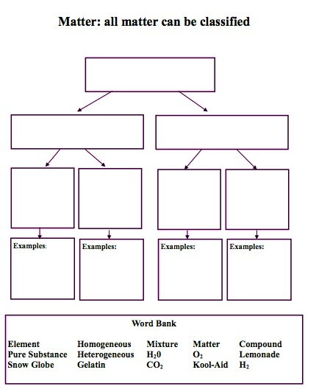
Station #2: Flow Chart
Please paste in your notebook
Use word bank at the bottom to fill in correct words to the flow chart
Next place notes in notebook on same page
Finish notes by filling in missing information
If you have extra time self quiz with the PowerPoint on the laptop.
You have 7 min

Slide 3
Station #3
http://www.ck12.org/book/CK-12-Physical-Science-For-Middle-School/section/3.2/
Start at “elements” (find definitions of the new vocabulary)
STOP at Elements and Atoms
You have 7min

Slide 4
Station #4
http://www.ck12.org/book/CK-12-Physical-Science-For-Middle-School/section/3.2/
Start at “elements and atoms”(find definitions of the new vocabulary)
STOP at “Mixtures”
You have 7min

Slide 5
Station #5
http://www.ck12.org/book/CK-12-Physical-Science-For-Middle-School/section/3.2/
Start at “Mixtures”(find definitions of the new vocabulary)
STOP at “Lesson Summary”
You have 7min

Slide 6
Homework
Write to someone who missed class. Tell them what they missed. What was important? What did you do?
Write like you are talking to a classmate/friend—still school appropriate.

